Slide 1
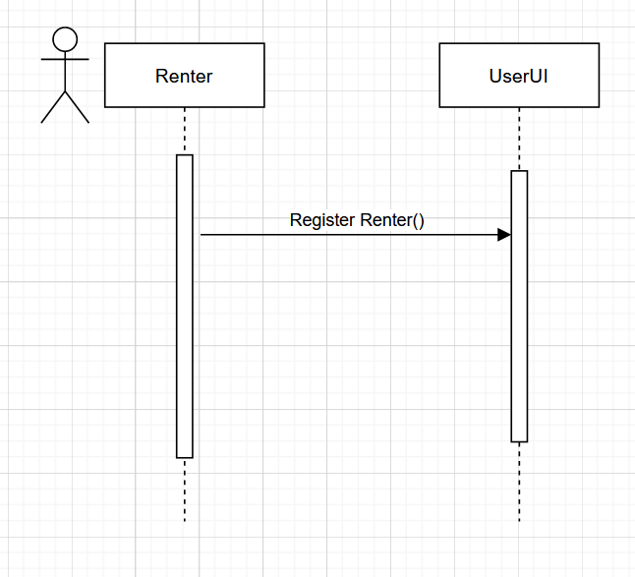
Use Case 01.01 Register Renter
Use Case Scenario:
As a new renter, I want to create an account on the platform so that I can start searching for available properties to rent.
As a renter, I want to be able to fill out my profile information, such as my name, contact information, and preferred location, so that landlords can contact me with suitable rental properties.
As a renter, I want to be able to upload documents such as my ID and proof of income, so that landlords can verify my identity and financial status.

Slide 2
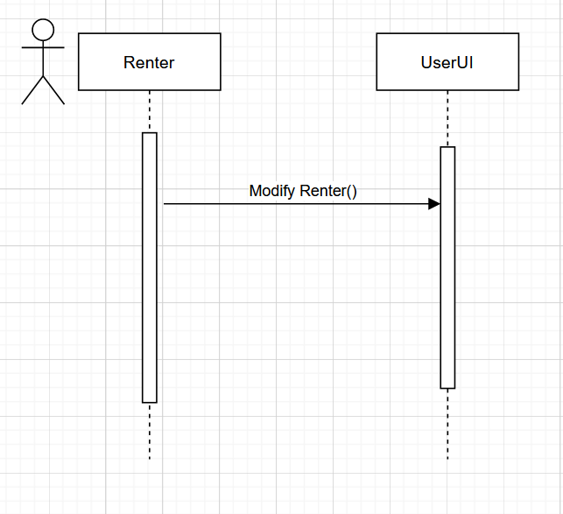
Use Case 01.02 Modify Renter
Use Case Scenario:
As a renter, I want to be able to update my profile information, such as my contact details or rental preferences, so that landlords can contact me with more relevant property listings.
As a renter, I want to be able to add or remove documents from my account, such as updated proof of income, so that landlords can verify my current financial status.

Slide 3
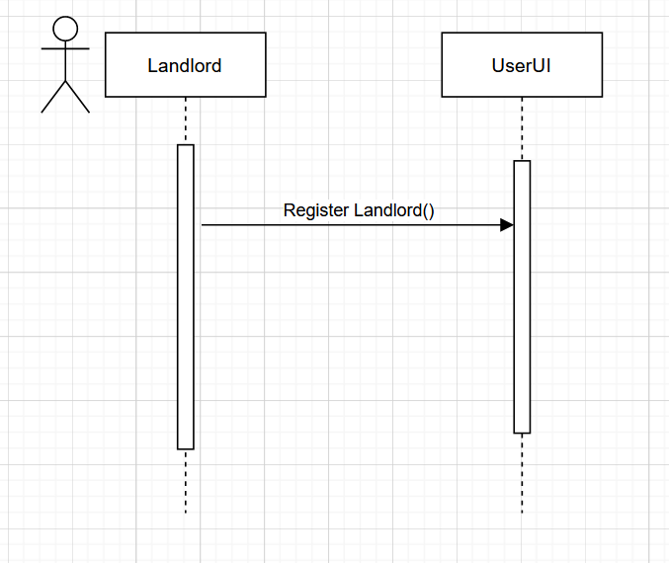
Use Case 01.04 Register Landlord
Use Case Scenario:
As a new property owner, I want to create an account on the platform so that I can list my properties for rent.
As a property owner, I want to be able to fill out my profile information, such as my name, contact information, and property details, so that renters can contact me with inquiries about my properties.
As a property owner, I want to be able to upload photos and details of my properties, including the number of bedrooms, bathrooms, and square footage, so that renters can view and filter available listings.

Slide 4
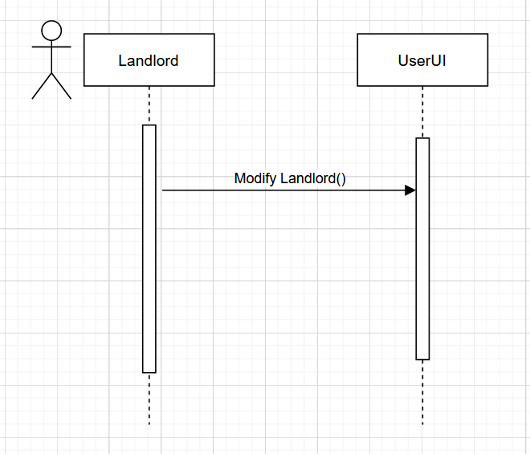
Use Case 01.05 Modify Landlord
Use Case Scenario:
As a property owner, I want to be able to update my profile information, such as my contact details or property details, so that renters can contact me with more relevant inquiries.
As a property owner, I want to be able to add or remove properties from my account, so that I can manage my rental listings.

Slide 5
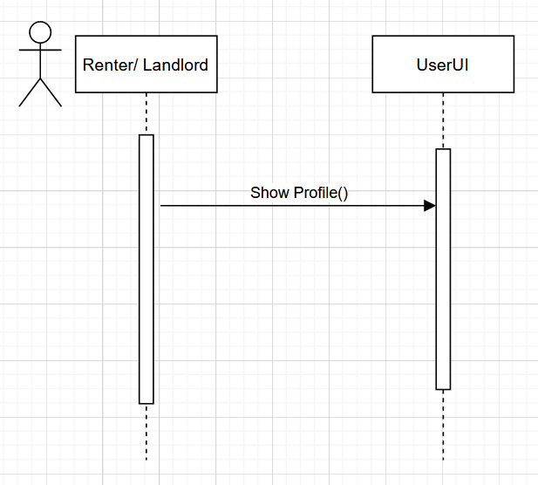
Use Case 01.07 Show Profile
Use Case Scenario:
As a registered user, I want to be able to view my profile information, such as my contact details and rental history, so that I can ensure it is up-to-date.
As a renter, I want to be able to view the profiles of landlords whose properties I am interested in renting, so that I can contact them with questions or to schedule a viewing.
As a landlord, I want to be able to view the profiles of renters who have expressed interest in my properties, so that I can verify their identity and financial status.

